Slide 1



OVERVIEW OF HIV TESTERS CERTIFICATION PROGRAM IN COTE D’IVOIRE
REPUBLQUE DE CÔTED’IVOIRE
Union-Discipline-Travail
MINISTERE DE LA SANTE DE L’HYGIENE PUBLIQUE ET DE LA COUVERTURE MALADIE UNIVERSELLE
DE
OSSEY CHO INES PRISCA
Pharmacist Biologist, Certification program coordinator
MOH/NPHL (National Public Health Lab)
June 4, 2024

Slide 2
OUTLINES
INTRODUCTION
OBJECTIVES
METHODOLOGY
RESULTS
LESSONS LEARNED
CONCLUSION

Slide 3
INTRODUCTION
2015: Adoption by the MOH of Rapid test Continuous Quality Improvement Initiative (RT-CQI) with CDC –PEPFAR support
2016 to 2019: Implementation by a CDC funded partner ( ITECH)
2019: Implementation successfully transferred to MOH
2020 to now: Implementation by the LNSP (National Public Health Laboratory)

Slide 4
INTRODUCTION
TEST and TREAT strategy
Accurate results
Early effective treatment and increased prevention
Key component
Assessing the competency of HIV testing sites providers
Quality and reliablity of HIV services

Slide 5
OBJECTIVES

Slide 6
General Objective:
Continuously monitor performances of HIV testing sites providers
Specifics Objectives:
1. Strengthen the provider's confidence in their work and results generated
2. Provide recognition of technical competence
3. Improving the accuracy and reliability of HIV diagnosis with rapid tests at testing point

Slide 7
METHODOLOGY

Slide 8
CERTIFICATION PROGRAM FRAMEWORK
Definition of national standards and procedures
Coordination and supervision of program implementation
Preparation and dissemination of program report
Dissemination of certificates to providers
Completion of written evaluations
Performing direct observations
Carrying out external audits and developing an improvement plan
Writing and transmission of reports to the management of the structure, the sub-committees and the health district
National Certification committee:
CNCEC/LNSP
Auditors
Coachs
District/ IPs
Coaching of testers on quality and certification requirements
Conducting internal audits
Ensure the implementation of corrective measures and the improvement plan
Ensure that staff was trained in national HIV testing modules
Promote written assessments
Identification and proposal of eligible testers for certification
Audit Report Review

Slide 9
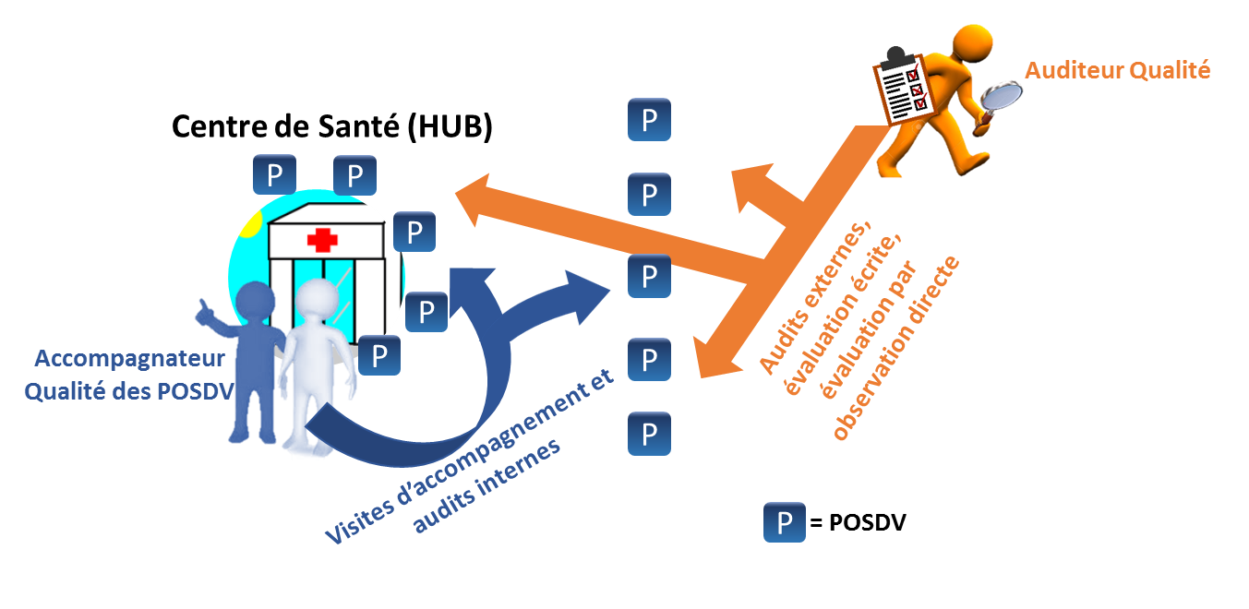
PROCESS
1- Providers selection
2- Coaching
3- Certification audit
1
3
2

Slide 10
PROCESS
1- TESTERS SELECTION
By: NPHL
Number of testers selected per year ≈ 250
Criteria: Volume of tests, Clinical Ips…
2- COACHING
By: National Quality Coachs
During 03- 06 months
3- AUDIT
Two steps
Theoretical phase: written assessment
Practical phase with direct Observation

Slide 11
CERTIFICATION AUDIT
WRITTEN ASSESSMENT
Quality assurance
Biosecurity and biosafety
Specimen collection and management
National HIV Testing Algorithm
HIV testing standardized logbook
Proficiency testing
Professional ethics
Stock management
Pre-test and post-test
DIRECT OBSERVATION using a checklist
Workstation layout,
Hygiene and biosecurity measures,
Pre and post-test advice,
Different stages of the test,
Use of standardized tools,
Recording of results
…

Slide 12

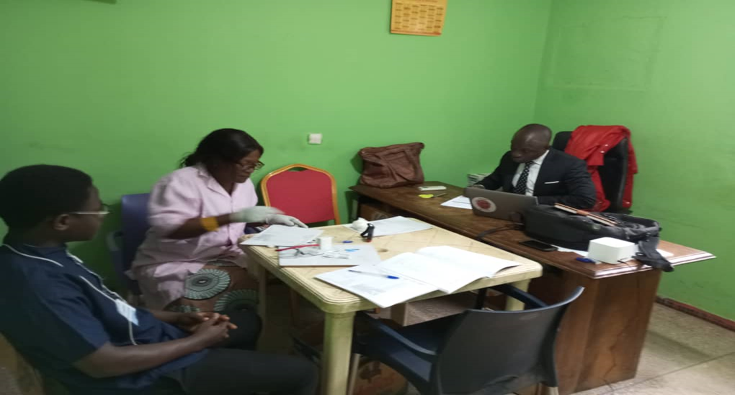
ELIGIBILITY CRITERIA
Competency assessment
Six months of HIV testing activities
Have received initial training in national HIV counselling and testing modules
Obtain a score ≥ 80% in the written assessment
Score ≥ 80% during direct observation
Obtain a score of 100% on the last HIV PT carried out by the provider in the last 12 months.
Certified for a period of two years

Slide 13
RESULTS (2022 and 2023)

Slide 14
RESULTS
Participation rate per type of sites
90,55%
90,03%
91,85%

Slide 15
RESULTS
Certification rate per year: Increased certification rate from 2022 to 2023
87%
59%
84%
65%
95%
46%
2022
Low certification rate for community providers
2023
Improved certification rate for community providers with trainings by Ips, refresher trainings for coachs and strong community engagement

Slide 16
RESULTS
Comparison of 2022 and 2023 results
Increase in the number of participants from 2022 to 2023
Improvement in the number of providers assessed as competent from 2022 to 2023

Slide 17
LESSONS LEARNED
Maintain the competency assessment of providers on an ongoing and periodic basis.
Educate HIV testing sites staff on the importance of HIV testing
Conduct periodic training and refresher workshops for testers
Have the commitment of all the stakeholders
Have the commitment of regions and districts leads: Organize workshops to present and raise their awareness of the tester certification program and its importance
Continuously train new pool of coaches and auditors
Ensure good coordination of the activity among all stakeholders.

Slide 18
CONCLUSION

Slide 19
CONCLUSION
HIV testers are key players in the continuous improvement of HIV testing through rapid tests. As a result, it is necessary for them to have specific knowledge and demonstrate formal competence

Slide 20
ACKNOWLEDGEMENT
Directorate General for Health
LNSP staff
Coachs
Auditors
Districts, Regions, Health centers
Implementing partners
CDC

Slide 21
MERCI DE VOTRE ATTENTION

